Slide 1
Atlas Labs: HR Analytics in Power BI Report

Slide 2
Abstract
Explore HR Analytics at the intersection of HR and data science, empowering organizations to optimize processes and elevate employee experiences. Using the Atlas Labs dataset, we reveal insights spanning recruitment, engagement, performance, attrition, and diversity. Discover evidence-based strategies for talent attraction, retention, and development. Through data-driven visuals and predictive models, learn how HR Analytics drives success and shapes forward-looking HR strategies. Unleash the power of data to foster innovation and growth in modern organizations.

Slide 3
Objective
Uncover Insights: Demonstrate how HR Analytics can extract valuable insights from the dataset, enabling evidence-based decision-making across key HR functions.
Optimize Strategies: Illustrate how data-driven analysis can optimize talent acquisition, employee engagement, performance management, attrition prediction, and diversity initiatives.
Enhance Decision-Making: Highlight the power of HR Analytics in making informed decisions, leading to improved processes, higher efficiency, and enhanced employee experiences.
Drive Organizational Success: Showcase how HR Analytics aligns with broader business objectives, fostering a culture of innovation and growth within organizations.
Inspire HR Leadership: Motivate HR leaders to harness the potential of data, encouraging them to adopt data-driven strategies for a competitive edge in the dynamic business landscape.

Slide 4
Report
Overview
What is the % attrition rate for Atlas Labs?
How many employees that were hired in 2021 are still with Atlas Labs?
What is the most common job role in the Technology Department?
Demography and Performance
How many active female employees do we have between the ages of 40-49?
What is the average salary of an employee who lists their ethnicity as "Mixed or multiple ethnic groups"?
Attrition
Which department and job role has the highest attrition rate?
What is the attrition rate for employees who are frequent travellers?
What is the attrition rate for employees with 5 years tenure at AtlasLabs?
What is the age of the oldest employee to have worked at Atlas Labs?

Slide 5
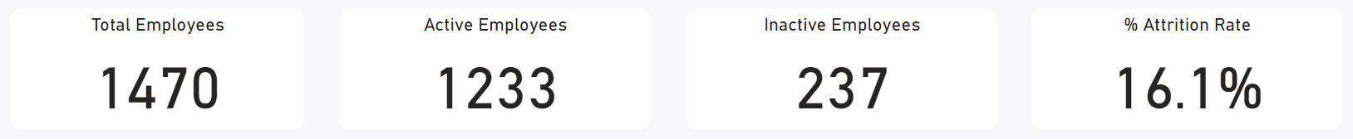
What is the % attrition rate for Atlas Labs?
There are 237 employees who are not active out of a total of 1470, if the percentage is 16.1%

Slide 6
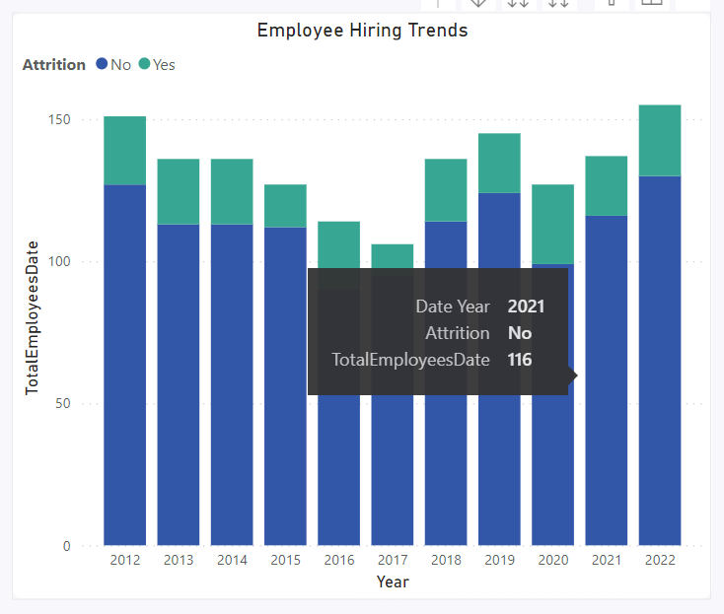
How many employees that were hired in 2021 are still with Atlas Labs?
From the graph on the right, we will hired 116 employees in 2021

Slide 7
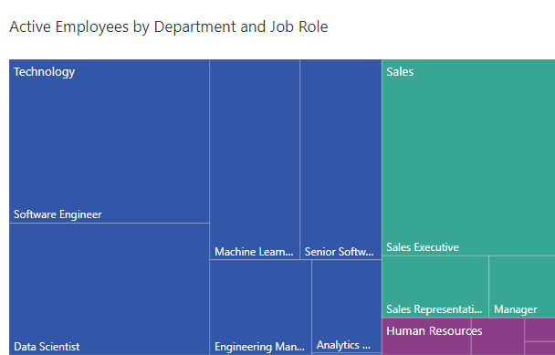
What is the most common job role in the Technology Department?
Most employees in the technology department sector are a Software Engineers

Slide 8
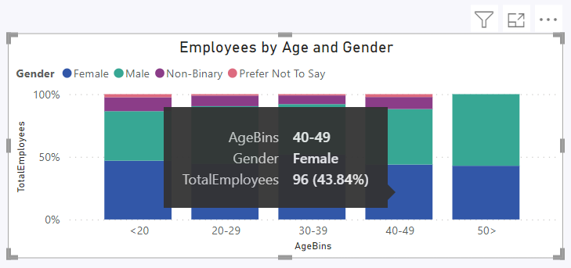
How many active female employees do we have between the ages of 40-49?
the number of active employees with female gender and aged between 40 - 49 is 96 employees and rate is 43.84%

Slide 9
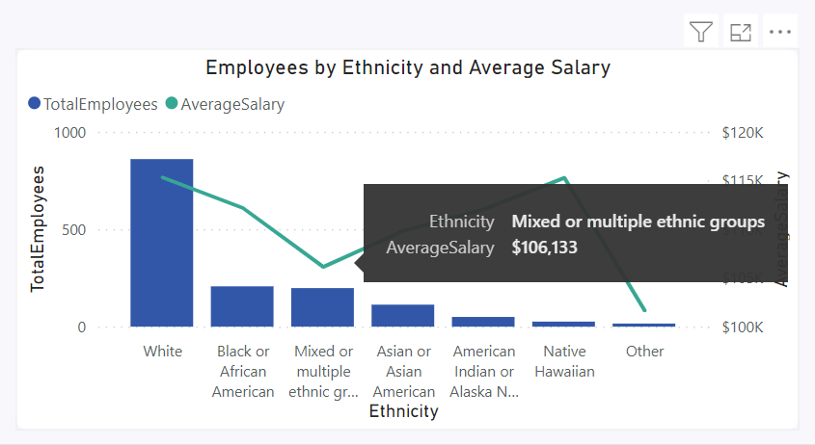
What is the average salary of an employee who lists their ethnicity as "Mixed or multiple ethnic groups“?
The average salary for employees in the "Mixed or multiple ethnic groups" category is $106,133

Slide 10
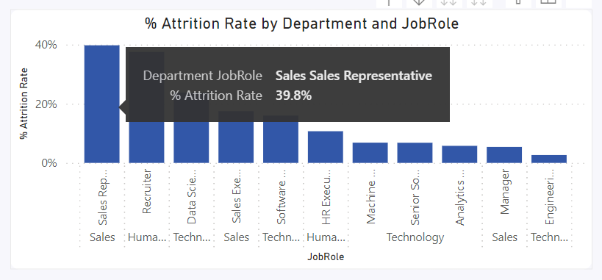
Which department and job role has the highest attrition rate?
From analyze with chart, Department and job role has highest attrition rate is a Sales – Sales Representative, and have a 39.8% of churn rate

Slide 11

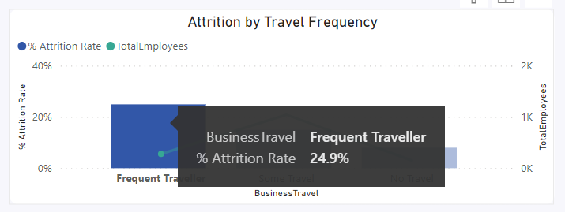
What is the attrition rate for employees who are frequent travellers?
From this analyze with chart, attrition rate for employees frequent travellers is 24.9%

Slide 12
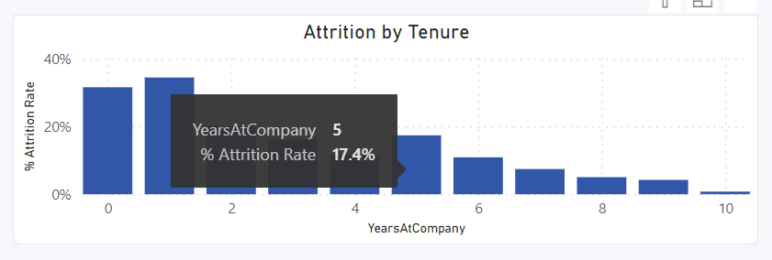
What is the attrition rate for employees with 5 years tenure at AtlasLabs?
Attrition rate for eployees with 5 years at AtlasLabs is 17.4%

Slide 13
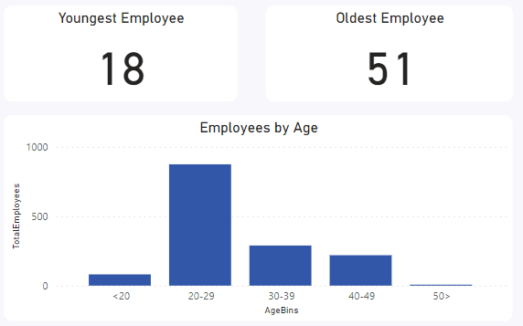
What is the age of the oldest employee to have worked at Atlas Labs?
Age from oldest employee have work at AtlasLabs is 51 y.o.

Slide 14
Conclussion
Insights on attrition
We can see from our last exercise that our employees that have been considered frequent travelers have the highest attrition rate despite only making up 19% of the total hires.
What action would you suggest HR take?
Review travel requirement policy and survey employees on feelings around travel frequency.

